Slide 1
Step 3 Azure SQL Database

Slide 2
Goal
Explore the database created by the application. Learn how to connect, explore and see some tools.

Slide 3





Choose your language and platform
Popular app languages
Popular platforms
Supports frameworks such as Entity Framework, Hibernate, Ruby on Rails, and Django.
Develop on Windows, Linux, or Mac
Leverage SQL Server & Visual Studio skills and tools across on-premises and Azure environments
Notes:
SQL Database are very accessible take what you know to connect to it

Slide 4
Connect with what you already know
SQL Server Azure SQL DB Azure SQL DW
ADO.NET
JDBC
ODBC
PHP Driver
db-lib
Node.js Driver
Tedious Node.js Driver
Pymssql
Django
TinyTDS
Rails
Pymssql
TinyTDS
ODBC
FreeTDS
ODBC
FreeTDS
FreeTDS
C#
VB.NET
Java
C/C++
PHP
JavaScript
Python
Ruby
Notes:
Any tool/IDEs that uses these drives works. Eg. Eclipse, JetBrains Data grip, Squierrl SQL,
Add list of IDEs that work across the drives.

Slide 5
Threat and anomaly detection Machine learning algorithms
Configurable threat detection policy
Built-in behavioral analysis
Real-time alerts
Explorable audit log
Unusual patterns are detected and fixed
Real-time threat alerts to admins
Machine Learning
SQL threat detection
Anomaly detection
Azure SQL Database
Web app
Real-time alerts to developers
External attacker / malicious insider
End user experiencing errors & issues
Notes:
Threat detection. As user activity occurs, built-in behavioral analysis monitors and provides real-time alerts if your database may be under threat.

Slide 6
Self-tuning performance Database Advisor
Continuously monitors query patterns and performance
Manages indexes, tailored to the specific workload
Tests and validates actions, reverts if impact negative
Runs in full auto-mode, or in recommend/review mode
Tuning algorithms
SQL Database
Database advisor
“My app gets auto-tuned”
“I can do more in less time”
Developer no admin skills
DBA of many databases
Notes:
Self-tuning performance. Query and operational patterns of your app are continuously monitored for effectiveness. Performance tuning is continuously implemented and automatically refined to adapt to changes in your app patterns, without your intervention.

Slide 7
Scale on the fly With no app downtime
Scale up with one click
Accommodate growth and peak workloads
Pay for what you need, when you need it
5 | 10 | 20 | 50 | 100 | 125 | 250 | 500 | 1,000 | 1,750 | 4,000
Database transaction units (DTUs)
Basic | Standard | Premium
Notes:
Scales performance on the fly, without app downtime

Slide 8

Business continuity with 99.99% availability Active geo-replication & point-in-time restore
Up to 4 readable secondaries
Active geo-replication
One-click configuration
One-click failover
One-click DR drill capabilities
Low RPO
Point-in-time restore
Automatic backups
Up to 35 days retention
Notes:
3 copies, backup, DR, etc. all very simple

Slide 9
Accelerate migration with Azure Database Migration Service
Azure Database Migration Service
SQL
Easily migrate your operational databases and data warehouses with a fully managed database migration service
Migrate your data seamlessly and reliably to the cloud at scale and with minimal downtime
Migrate SQL Server & 3rd party databases to Azure SQL Database
MySQL
SQL
Notes:
Tools are available to migrate :Database Migration Service (DMS) is a fully managed service

Slide 10

Tools
Command-Line
Azure PowerShell
Azure CLI
Languages
.NET
Java
Node.js
Python
Ruby
PHP
T-SQL
Azure Portal
REST
REST API Reference
SQL Server Tools
SQL Server Tools
SQL Server Management Studio (SSMS)
SQL Server Data Tools (SSDT)
BCP
SQLCMD
SqlPackage
SQL Database Management Library package
VSCode
Visual Studio
Notes:
Just to say a LOTS of tool are available, we will present some in the demo part.

Slide 11
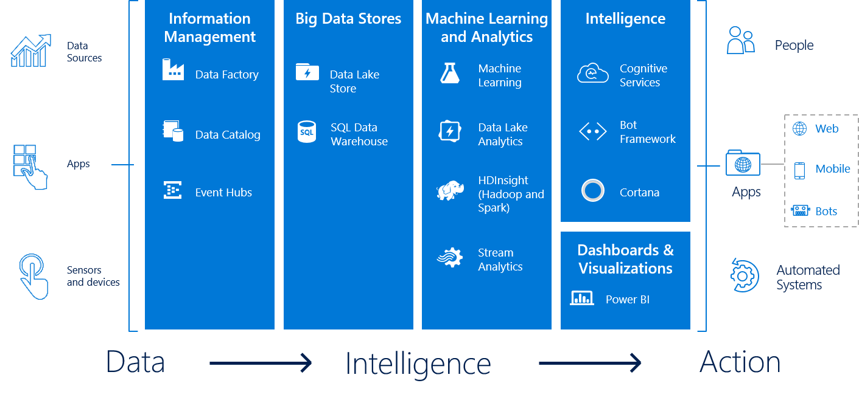
Notes:
Data Platform is a big family
Note: Today MySQL and PostgreSQL are also available SaaS

Slide 12
Let’s code!

